Slide 1
Savings Group and Savings-led Microfinance
Community of Practice
September 2022

Slide 2
Agenda
Welcome: Prayer and logistics
Introductions
Presentations
Discussion
Networking minute
Next steps

Slide 4
Introductions in the chat
Name
Organization
Where you call home

Slide 5
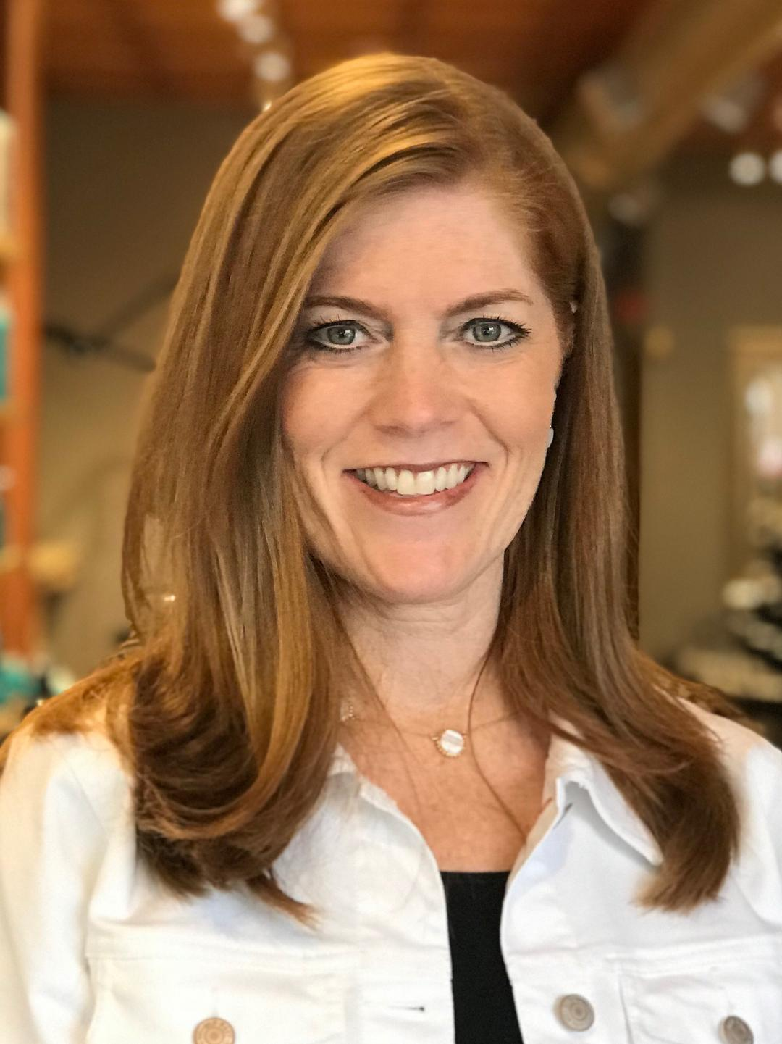
Julie Cominos
Grants Program Manager, USG/Institutions
World Renew
Julie Cominos works within the World Renew’s Program Excellence team, as a Grant Manager seeking funding for international programming in 19 countries, as well as supporting the local capacity building of our field staff and partners in USG/Institutional grant management. Currently she supports the Uganda team in their implementation of the Women in Resilience in Teso Project, funded as one of the five Innovators of the former SEEP network, focusing on women economic empowerment and resilience. The innovators were funded by the SEEP network, in partnership with the Gates Foundation.

Slide 6
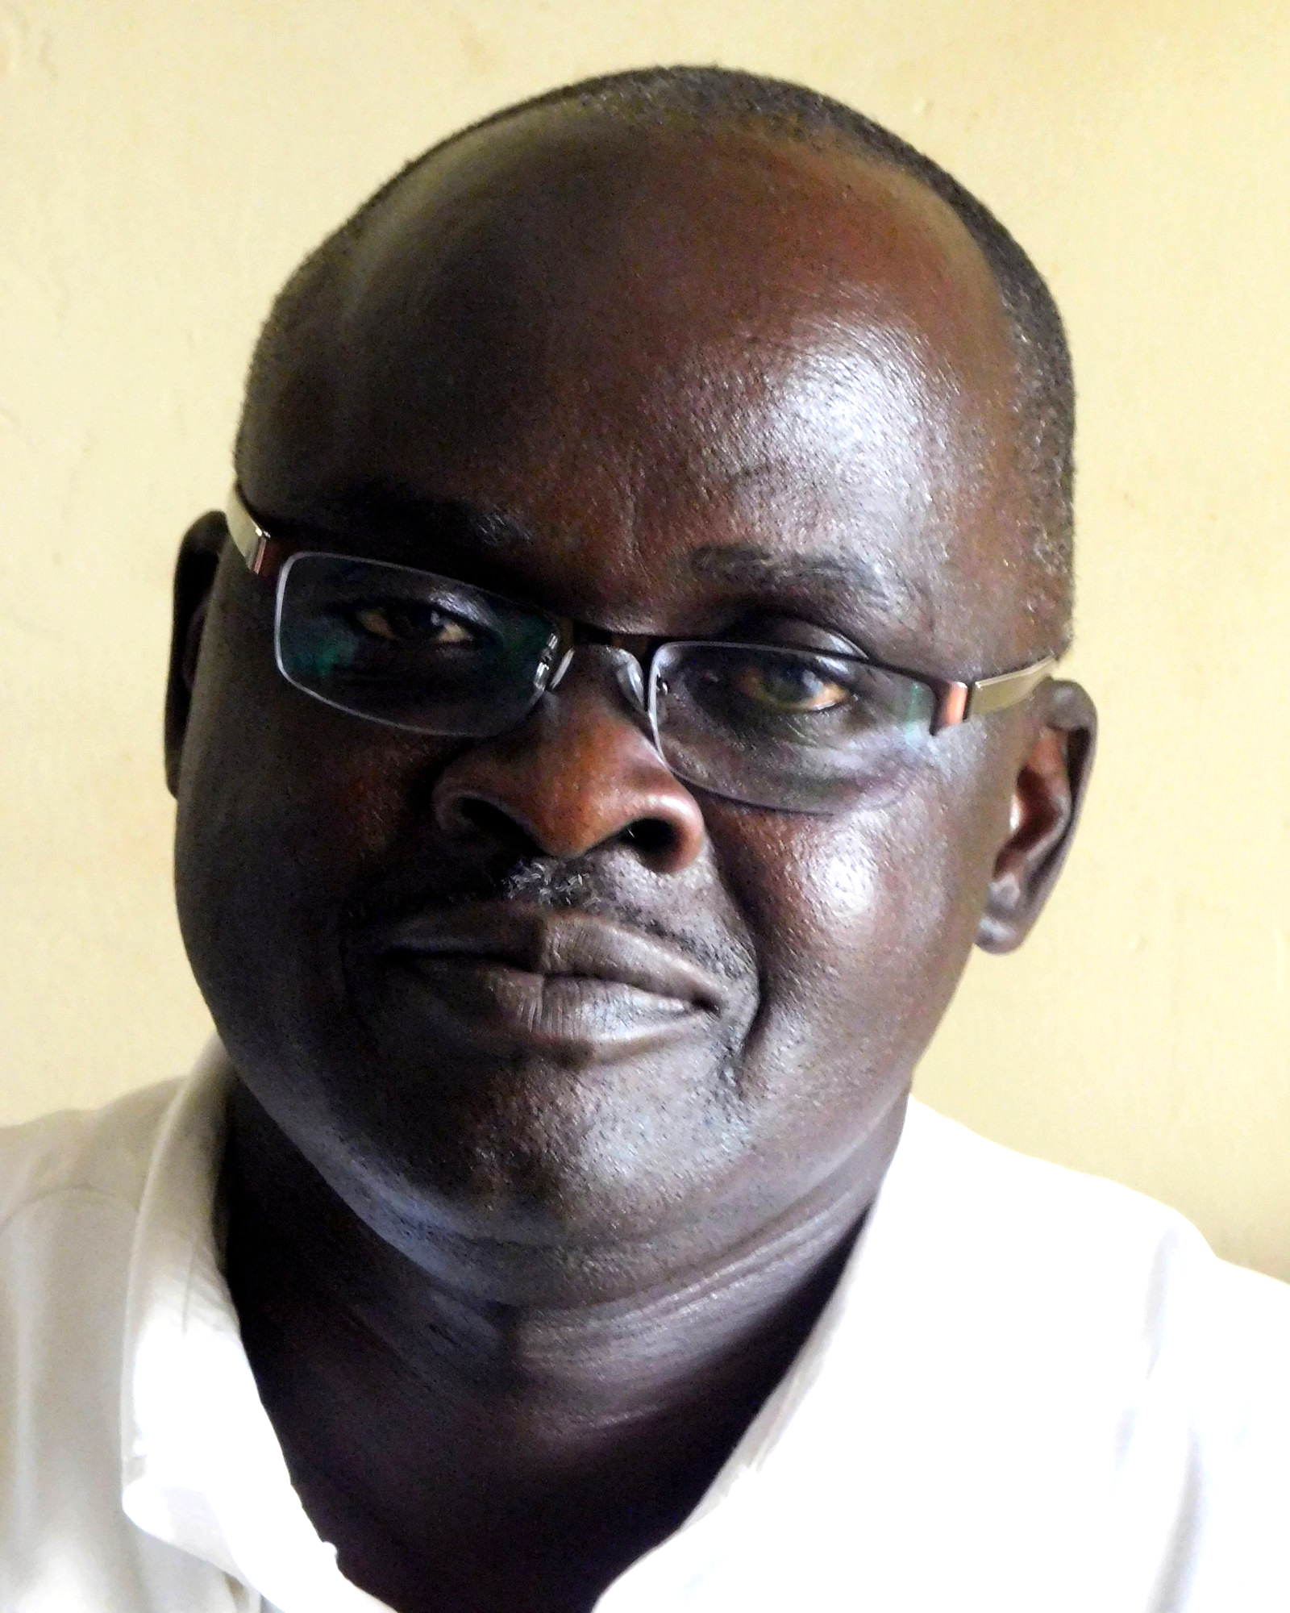
Edward Okiror
Program Consultant
World Renew Uganda
Edward Etanu Okiror has worked as the Program Consultant for 13 years in Uganda, in partnership with three churches and partners in (Northeastern part of Uganda). Currently he works alongside PAG churches and supports their capacity to manage locally led development projects. As lead Project Manager of the former SEEP funded WRT innovator project, Edward and team support communities to create, build and sustain thirteen (13) Cluster Level Associations composed from one hundred and twelve (112) women led VSLAs. These CLAs are a powerful platform for amplifying the voices of women, to advocate for their communities and their livelihoods.

Slide 7
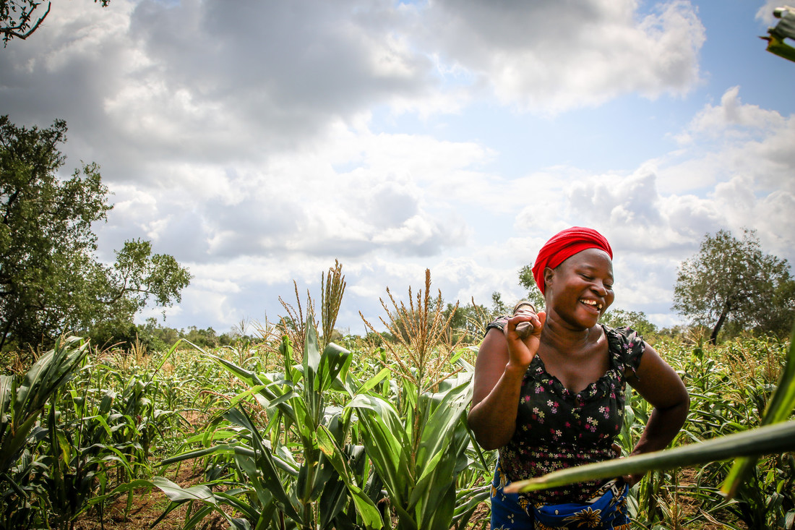
World Renew Uganda 2021-22
WOMEN’S RESILIENCE IN TESO
Through Cluster Level Associations
Notes:
Alice

Slide 8
World Renew & PAG West Teso and PAG North Teso
8
World Renew partners with 6 Ugandan organizations to strengthen their capacity to implement effective and appropriate community driven development.
PAG WT: Works with rural families in the Kaberamaido and Kalaki districts in VSLAs, food security, and adult literacy.
PAG NT: Works with rural families in the Katakwi and Amuria districts in economic livelihoods, food security, conflict resolution, and HIV/AIDS response.
Notes:
Alice:World Renew is registered in Uganda as a Foreign NGO Reg. No.S.5914/202 and has been active in Uganda since 1982.

Slide 9
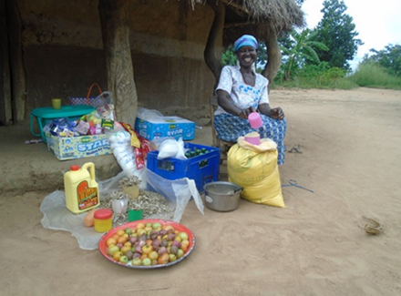
Project Innovation and Intermediate Outcomes
9
Innovation:
Enhanced capacity of Cluster Level Associations (CLAs) and their savings groups to respond to gendered impacts of COVID-19.
Increased support for women and girls from forms of violence, including GBV and early marriages.
Improved shared decision making at the household and CLA/VSLA level and control over assets and resources between women and men.
Increased connectivity between CLAs and key service providers and resources in the region.
Notes:
Edward: After saying INT 1000: IMM Outcome 1100: Increased awareness and commitment to gender and child rights among saving group members. IMM Outcome 1200: Increased ability of the women and savings groups to address behaviors, norms and values related to GBV through dialogues and collective action.
After saying INT 2000: IMM 2100: Increased awareness of men and women on the value and importance of shared decision making at the household and community level. IMM 2200: Increased knowledge and use of business adaptive strategies among members of the savings groups.
After saying INT 3000:IMM 3100: Increased confidence and knowledge on how to advocate and lobby.
IMM 3200: Increased awareness of the role of CLAs as platforms for socio-economic community transformation.

Slide 10
Cluster Level Associations (CLAs)
10
VSLAs join together and form a CLA in order to:
Collectively advocate for resources from local government and other sources.
Function as CBOs capable of supporting local initiatives in sustainable agriculture, healthcare and education.
Foster female leaders and women lead change.
To be a voice for justice.
Notes:
Edward: Collectively advocate for resources from local government and other sources, achieve economies of scale for purchasing power and access formal financial institutions.
• Function as community based organizations capable of supporting local initiatives in sustainable agriculture, healthcare and education.
• To be a voice for Justice to the marginalized and vulnerable in the communities.
• In addition to advocating and coordinating activities, leaders are developed, many of whom are women who have not previously had leadership training or opportunities.

Slide 11
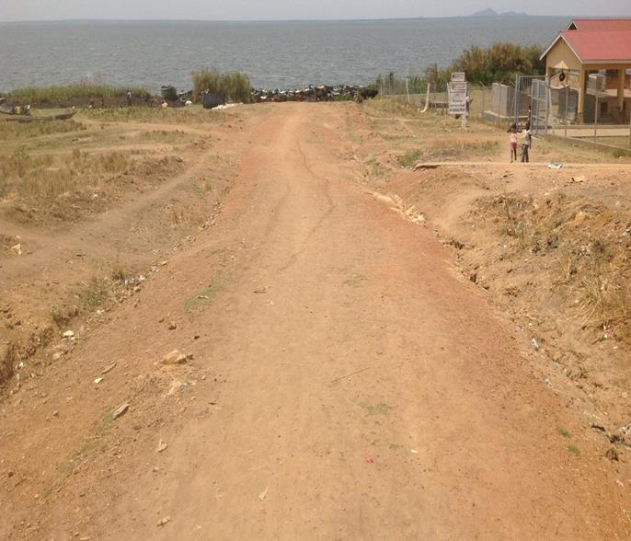
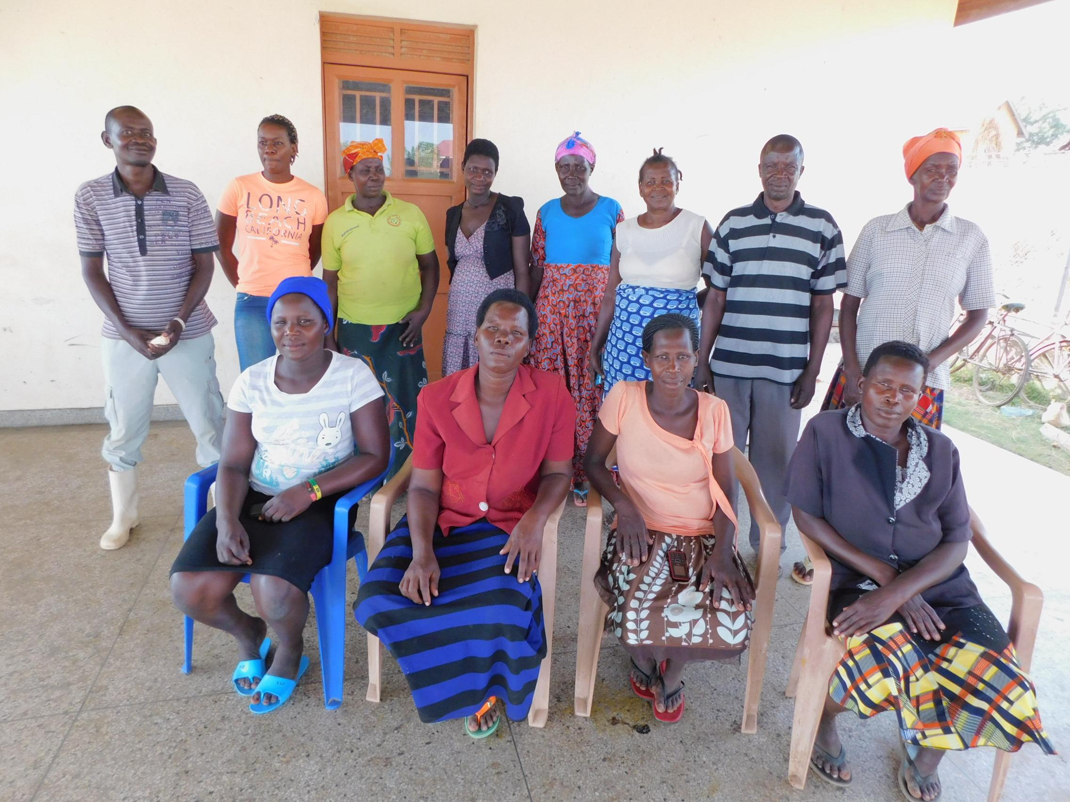
11
Successes of CLAs
CLA lobbied local government for opening of roads for improved access to the Akampla fishing community.
CLA advocated for clean and safe water provision for Atugo, Kaberamaido.
Notes:
Edward

Slide 12
CLA Manual: Facilitating Women’s Empowerment by CLAs
12
Tools for Facilitating Community Dialogues: The Manual will be a step by step on "how to" hold community-based dialogue sessions.
Tools for Advocacy: Provide information and simple tools that develop and enhance advocacy skills and strategies.
Notes:
Edward: Who is to use this tool kit: The tool kit is meant to be used by: World Renew, its partners and external stakeholders.

Slide 13
CLA Manual: Facilitating Women’s Empowerment by CLAs
13
Information on best practices around community-based dialogues and advocacy will be collected and compiled regularly by the two M&E officers over the course of project implementation.
An external consultant has led the process of identifying, collecting and compiling information for the CLA Manual.
Notes:
Edward: · The toolkit could contain information that will be collected and compiled regularly by the two M&E officers in the course of project implementation.
·An external consultant shall also be engaged to guide in the process of Identifying, collecting and compiling the Tool kit that it shall be a standard easy to use and effective Tool kit for community transformation.
·Secondary information/ data shall also be sourced by the consultant from other sources like: Steppingstones manual, Current CLA manual, and others and shall be acknowledge and referenced.
· Two workshops shall be held, facilitated by the Consultant, to plan- at the beginning of the Project and discussing the draft tool kit towards the end of the Project.

Slide 14
CLA Manual: Draft Outline
14
Module 1: UNDERSTANDING AND ESTABLISHING CLUSTER LEVEL ASSOCIATIONS (History, Rationale, Composition, Features, Formation, Preparation for Formation, Self Evaluation, Representatives, Relationships).
Module 2: CLUSTER LEVEL ASSOCIATION GOALS, VISION AND STRUCTURE (Governance Structure, Rules & Regs, Record keeping, Sub Committees, WR Best Practices).
Module 3: CLUSTER LEVEL ASSOCIATION AS THE “PEOPLE’S INSTITUTION” FACILITATING COMMUNITY CHANGE (Facilitating Community Dialogue and Processes, Advocacy, Process/Facilitation of Justice and Advocacy, Networking and Mobilization of Resources for CLA).
Module 4: IMPLEMENTING CLUSTER LEVEL ASSOCIATIONS TO ENHANCE GENDER EQUALITY AND WOMEN’S RESILIENCE (Role of CLA in Reducing Gender Based Violence (GBV), Enhancing Women’s Voices and Agency, Improving Economic Inclusion of Women and Resource Mobilization).
Module 5: CLUSTER LEVEL ASSOCIATION SUSTAINABILITY: WHAT IS THE NEXT STEP FOR CLUSTER LEVEL ASSOCIATIONS (Building Partnerships, Legal Standing/Status of CLAs, Financial and Institutional Sustainability).
Module 6: MONITORING AND EVALUATION (WR Best Practices for MEL with CLAs, Specific Approaches and Impact, Comparative Analysis for WR approaches to M&E for CLA vs Other Peer Organizations).
Notes:
Edward: · The toolkit could contain information that will be collected and compiled regularly by the two M&E officers in the course of project implementation.
·An external consultant shall also be engaged to guide in the process of Identifying, collecting and compiling the Tool kit that it shall be a standard easy to use and effective Tool kit for community transformation.
·Secondary information/ data shall also be sourced by the consultant from other sources like: Steppingstones manual, Current CLA manual, and others and shall be acknowledge and referenced.
· Two workshops shall be held, facilitated by the Consultant, to plan- at the beginning of the Project and discussing the draft tool kit towards the end of the Project.

Slide 15
CLA Manual: Timeline of completion process
15
2022
July - September
Draft Review, Edit and Discussion between WR Uganda and WR Home Office (USA/CA)
September
Completion of draft; Review by Technical Expertise and Project Management planning
Oct-Dec
Final review; Completion of Project Implementation Activities (postponed due to COVID lockdowns).
End 2022:
Final CLA Manual Completed. Dissemination plan developed and approved; Sharing and Presentation of Final Manual.
Notes:
Edward: · The toolkit could contain information that will be collected and compiled regularly by the two M&E officers in the course of project implementation.
·An external consultant shall also be engaged to guide in the process of Identifying, collecting and compiling the Tool kit that it shall be a standard easy to use and effective Tool kit for community transformation.
·Secondary information/ data shall also be sourced by the consultant from other sources like: Steppingstones manual, Current CLA manual, and others and shall be acknowledge and referenced.
· Two workshops shall be held, facilitated by the Consultant, to plan- at the beginning of the Project and discussing the draft tool kit towards the end of the Project.

Slide 16
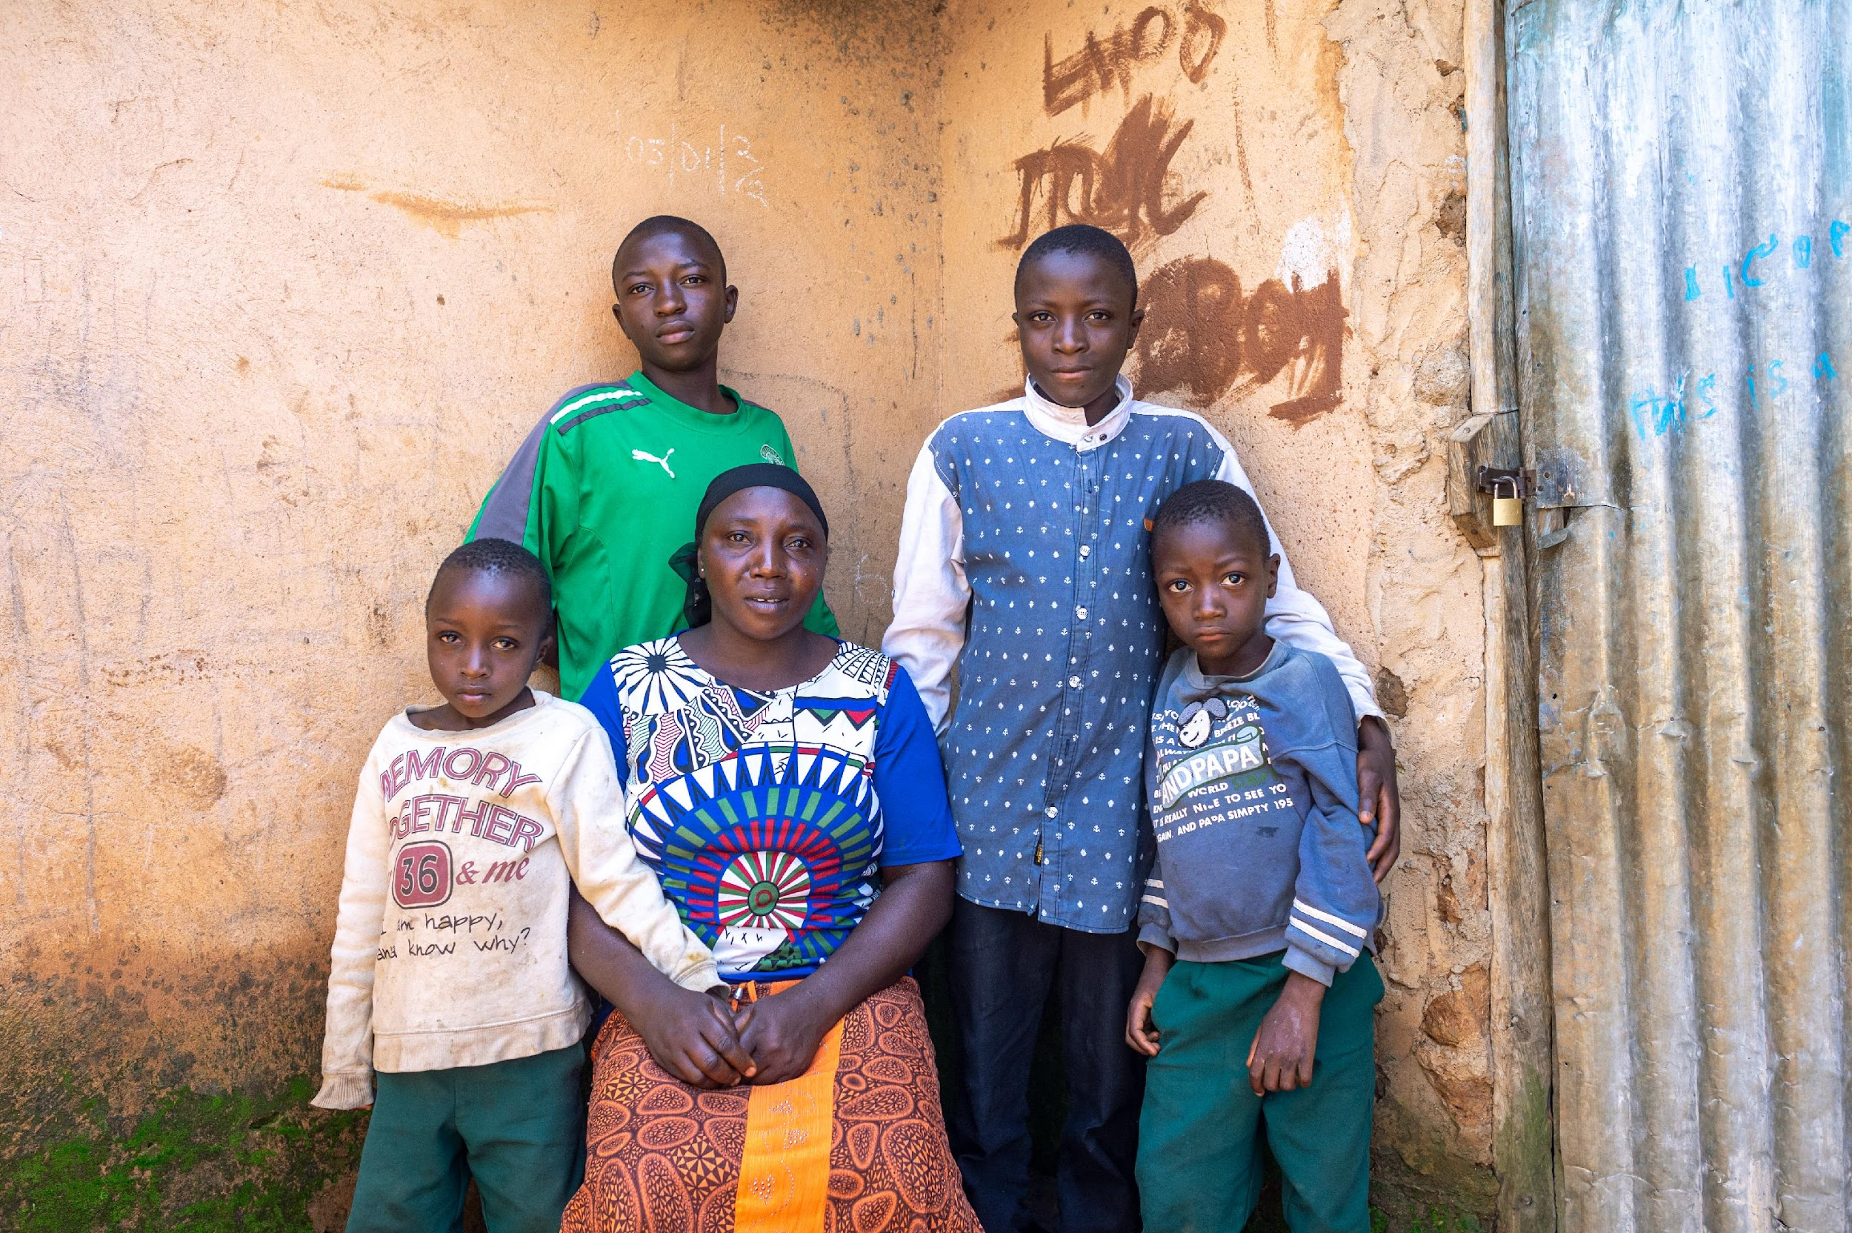
THANK YOU
worldrenew.net
16
Notes:
Edward: Thank you and Questions

Slide 17
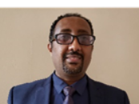
Ephraim Tsegay
Strategic Project Lead – Africa
Tearfund
Ephraim Tsegay is a seasoned business strategist, organizational and team developer, and innovator. He holds an M.A. in Counseling Psychology and MSCs in Transformation and Learning from the University of Manchester and Staffordshire Universities in the UK. He has over 20 years experience in the humanitarian aid and development sectors and specializes in: self-help groups development, church and community transformation work, organizational learning, change management, and strategic leadership.

Slide 18
INTRODUCING
Tearfund’s Experience on Federation Level Associations (FLAs)
21 Sep 2022
Ephraim Tsegay
Strategic Project Lead-Africa Regions

Slide 19
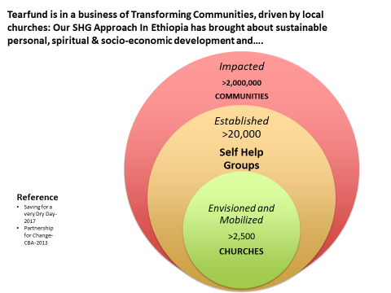
BACKGROUND
So far, Tearfund has supported the establishment of over 33,000 SHGs across Africa.

Slide 20
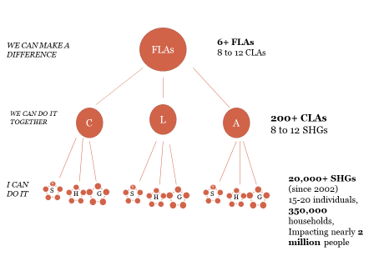
BACKGROUND
IN ETHIOPIA ALONE, TEARFUND HAS

Slide 21
DESCRIPTION OF SHGs
Self Help Group (SHG) is an informal association of poor people in a community with a common objective of working together to bringing about transformation at household and community levels.
Each SHG consists of :-
15-20 homogeneous and volunteer members, with greater affinity, a shared purpose, a self regulating bylaws, and division of roles and responsibilities including 2 book writers, 2 bank signatories and 2 Cluster Level Association (CLA) representatives,
SHGs set up Clusters, and Clusters form Federations

Slide 22
UNDERSTANDING FLAs (WHAT, WHY and HOW )
Federation Level Association (FLA) is an institution in its own right with a unique identity: It has clear vision, mission, goals, governance & management structure
FLA is made up of three to five representatives from constituent CLAs (8-12 CLAs)
FLA has an Executive Committee to act on behalf of the representatives of the Federation. The executive Committee members are selected from among the Federation members based on criteria set by the Federation.
The Executive Committee members serve for a fixed term.

Slide 23
UNDERSTANDING FLAs (WHAT, WHY & HOW )
WHY do we establish FLAs?
To Secure, to Scale up and to Sustain the SHGs Approach
To Influence Policy and Practices in favour of SHGs and Poor Communities
FLAs Operate in BY?
Securing Legal Entity/Registration for Groups.
Reinforcing CLA structure
Building Movement
Influencing Policy & Practice through Dialogue & Campaign
Engaging in Learning, Innovation & Research

Slide 24
UNDERSTANDING FLAs (WHAT, WHY and HOW )
Cond…
…..FLAs ?
Meet Every Month
Have own Bylaws
Plan to engage in Community Peacebuilding initiatives and addressing Justice and right Issues,
Provide Need based Services to members,
Plan and Engage in Social Actions
Represent SHGs in different platforms

Slide 25
IMPACT: FLAs (WHAT, WHY and HOW )
WHAT have we achieved So far with FLAs?
Lobbied and engaged in advocacy work to achieve Independent legalisation of SHGs in the Oromia Region of Ethiopia. Scaling legalisation to other regions is in progress
Linked SHGs with MFI and able to access over 10 million Ethiopian Birr loan
Supported Cost benefit Analysis Research on SHGs that shows for every £1 spent, the return is as much as £173.
Mobilized SHGs for social action: planted over 200k tree seedlings, secured plot of land from government,
Supported the development of over 100 CLAs and establishment of thousands of SHGs in other regions

Slide 26
IMPACT: FLAs (WHAT, WHY and HOW )
WHAT have we achieved So far with FLAs?
Become champions on diversity and Inclusion: People with Disability, Elderly People and Minorities
Pioneered the setting up of SHGs for Children. ‘ 5 Children SHGs established: For talent sharing, promotion of saving habits, etc. and has Generational Impact
Led Complementary Digital Currency to coping up with impacts of Covid-19
Facilitated SHG data management System
Mobilised SHGs to provide material and financial support to disaster affected and displaced communities,
Supported public initiatives and bought bonds

Slide 28
Discussion
What stood out to you?
Does your organisation cluster or federate groups? Why? Why not?
What is relevant to your organisation from these presentations?
What do you want to learn more about?

Slide 29
Networking Minute (Breakout rooms)
Share your details in the chat
Consider what you have learned today and what connections you want to make as a result.
Consider future engagement with the CoP—what are topics that you have expertise in that you would like to share with your peers?
Notes:
First chance to share your details informally in the chat—good for people who don’t want to use the contact sharing sheet that we will discuss later.

Slide 30
Next Steps
Review the Charter
Share your ideas for next CoP
Contact the presenters if you have follow-up questions
Ephraim Tsegay | Julie Cominos
ephraim.tsegay@tearfund.org | jcominos@worldrenew.net
Edward Okiror | Anne Figge
eokiror@worldrenew.net | AnneFigge@fivetalents.org
Notes:
Charter
You will see a link for the charter in the chat—it will also come via the wrap up email form the CoP.
At this point we are not asking people to sign the charter because:
Lean towards informal
This is a fluid space
But we will review after one year
Google sheets for contact sharing:
You will see a link for the contact sharing sheet in the chat—it will also come via the wrap up email form the CoP.
You have to Opt in for contact sharing—read the disclaimer and put in your own details or don’t—whatever you feel comfortable with.
Trying to strike the right balance between confidentiality and community
Acknowldge that it will be difficult to please everyone
You will have a chance to amend this sheet at every meeting—or by contacting the admin address that we have also put in the chat.

