Slide 1
CED Roundtable on the “Next Normal”
What will our work look like after COVID-19?
July 16, 2020

Slide 2
Engage in the conversation
CED Roundtable on the “Next Normal”
What will our work look like after COVID-19?
July 16, 2020
Slide here to adjust
Keep your mic off when you’re not speaking
Use video when you can
Use the chat roll to ask or answer questions
View using
side-by-side mode

Slide 3
Agenda
Welcome: Prayer and logistics
Introductions using the chat roll
Presentation from our speakers
Open roundtable discussion
Share available resources
This session will be recorded

Slide 4
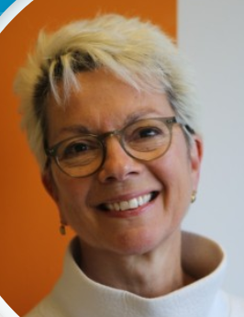
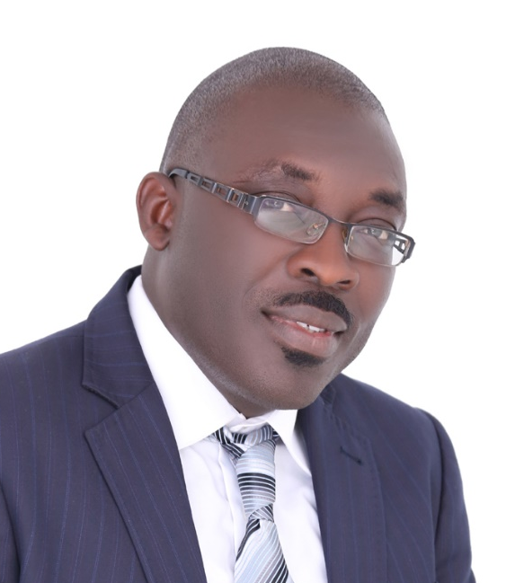
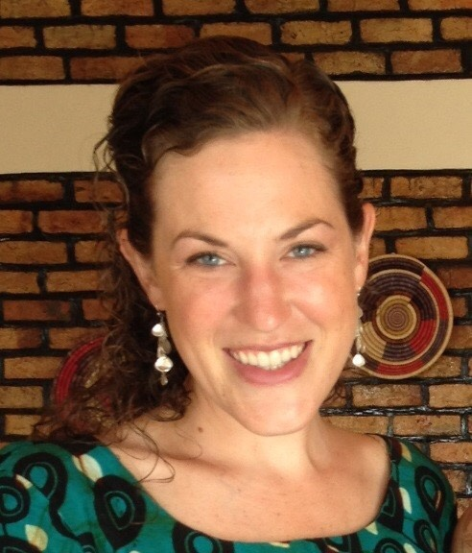
Our presenters
Johanna Ryan
Global Director- Impact VisionFund International
G. P. Gontrand Nounagnon
Regional Operations Director- West Africa
VisionFund International
Courtney Purvis
Senior Program Advisor – Savings for Life
World Relief

Slide 5
What have you learned during the COVID pandemic?

Slide 6
Learnings from VisionFund International
Johanna Ryan
Global Director – Impact

Slide 7
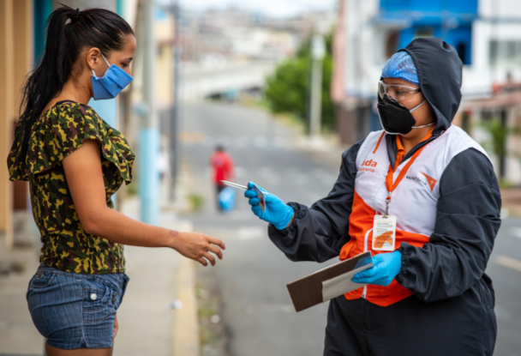
VisionFund Observations – Global Perspective
Communicate
Analyze
Prepare

Slide 8
Learnings from VisionFund International
G. P. Gontrand Nounagnon
Regional Operations Director – West Africa

Slide 9
VisionFund Observations in Africa Region
Serious crisis
Impact delayed
Direct impact on health is less disastrous than predicted
Indirect impact on health system, jobs and economy is huge
Engagement with MFI partners/funders: renegotiate time of deliveries and borrowing installments
Explain VisionFund’s two-phased approach – liquidity and resilience

Slide 10
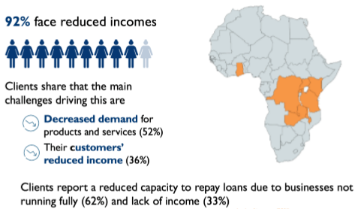
VisionFund Observations in Africa Region
Listen to clients – survey of 2,400 MSME in 8 countries
60% earning less than half of pre-Covid19 income
Sale of assets/livestock 13% (men 15%, women 12%)
Reduced consumption
food 59%
clothing 49%
education 29%
Biggest worries
business failure 39%
no income/
loss of capital 21%
catching virus 6%
MSMEs needs
loan rescheduling 51%
interest rate discount 44%.

Slide 11
VisionFund Performance in Africa Region
Senegal, Ghana & Mali – three very different situations
KPI comparison between February and May/June 2020
The more drastic the lockdown, the more severe the impact on the MFI
KPI | Senegal | Ghana | Mali
Portfolio quality (PAR30+LLR) | x13 deteriorated by factor of 13 | 56% end May Improving end June | -23% Improved
Number clients | -12% May 22,135 Improving end June | -16% | +0.6%
Portfolio value | -11% end May | -13% | +0.2%

Slide 12
Learnings from World Relief
Courtney Purvis
Senior Program Advisor – Savings for Life

Slide 13
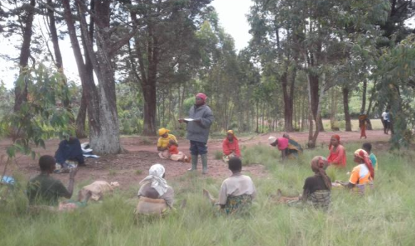
Savings Groups and Covid19: Lessons Learned
SGs are made for a time like this
Each country has/had a different level of response
We need to
think about
long term
economic
impacts
Notes:
Groups put in place measures to ensure that they should not lose money. In our case, one group called Msintha Moyo (Life Changer) invested all their savings in buying maize which they have stored. Their reasoning was that they will sell at a later point fully aware that with movement restrictions, they may have an advantage with probability of prices going up
Strict lockdown: can’t work / can’t save
Medium/flexible lockdown: groups meeting in small quorums
(few) no lockdown: business as usual

Slide 14
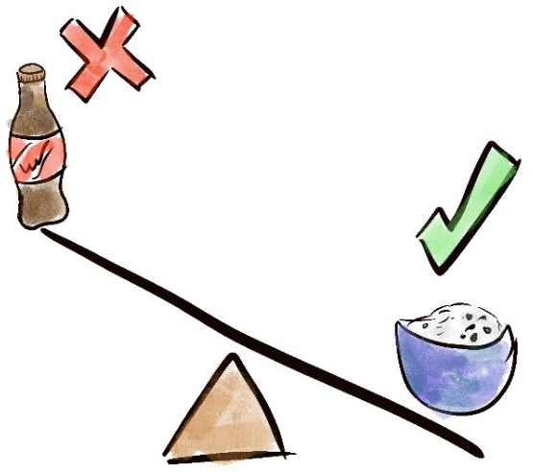
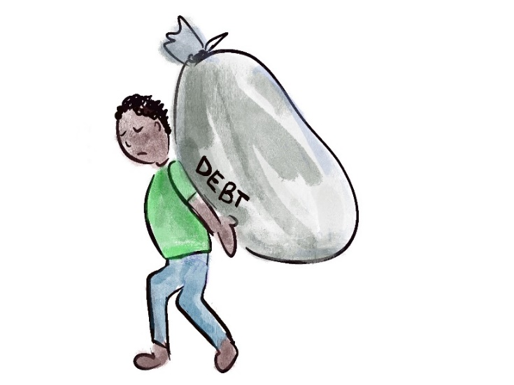
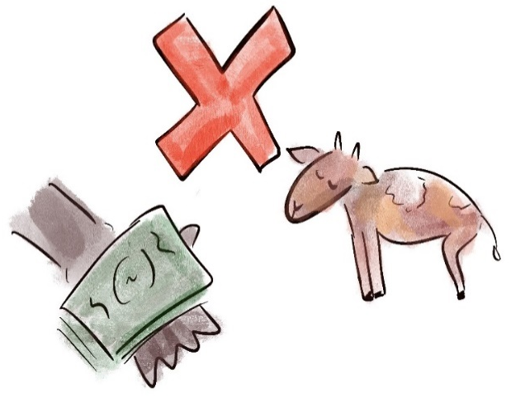
Smart Money During COVID-19
1. Prepare for the long-term
4. Avoid new loans or debt
2. Continue saving
5. Do not sell productive assets
3. Control your spending
6. Save money by growing your own nutritious food
Illustrations by Stephanie Ebert

Slide 15
What realities are you planning for in the future? What will change or stay the same?

Slide 16
Learnings from World Relief
Courtney Purvis
Senior Program Advisor – Savings for Life

Slide 17
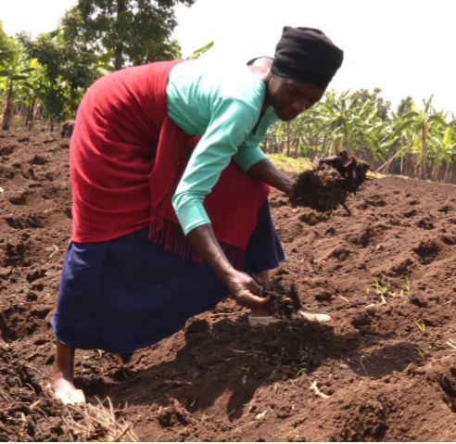
Talk to donors about flexibility in targets/programming Think about farming/kitchen gardens integrated into SG activities
Savings Groups and Covid19: Future Planning

Slide 18
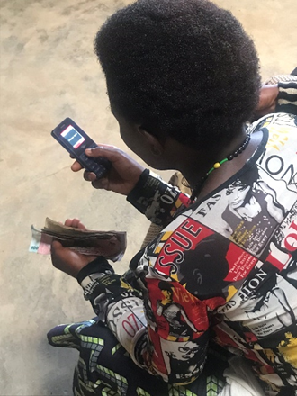
Think about digital savings groups
Savings Groups and Covid19: Future Planning

Slide 19
Learnings from VisionFund International
G. P. Gontrand Nounagnon
Regional Operations Director – West Africa

Slide 20
VisionFund Africa Region Plans and Assumptions
Support recovery of clients
Response (targeting, cash transfer, etc.)
Recovery (recovery loan, experience Typhoon Haiyan, El-Nino/Flood)
Improve MFI efficiency
Digitization (MIS full capabilities, Momo, process automation)
Rationalization (re-zoning, staff redeployment)
Appropriate funding for post-Covid operations
Special funding with no or reduced interest to MFI to cascade to clients
Special recovery loan, special support mechanisms
What will stay: focus on tech and digital, remote working, less travel

Slide 21
Learnings from VisionFund International
Johanna Ryan
Global Director – Impact

Slide 22
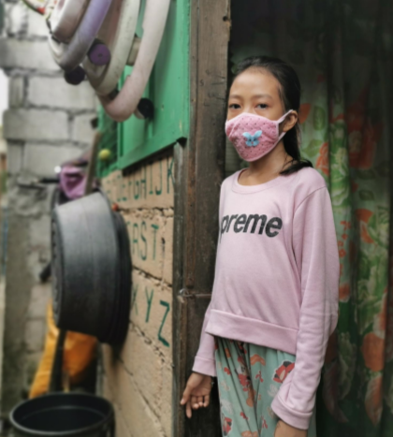
VisionFund Plans – Global Perspective
Livelihoods are critical
Focus on jobs, women, youth
Funding will change
Innovate and adapt
Rationalise and simplify
Reduce overhead costs

Slide 23
Polling questions
(anonymous)

Slide 24
Next Normal Assumptions
from HOPE International
Travel: Domestic travel by 2020 year-end; International travel resumes in 2021
Technology: Usage will increase to communicate globally and transact with those we serve (but many that we serve who will continue to use cash)
Fundraising events (domestic): Resume with some exceptions, social distancing by 2021
Group gatherings (international): Savings and microfinance groups will continue to meet but with more social distancing
Opportunities to serve: COVID will give us greater opportunities to care well for those we serve and will inspire new strategies for how we can serve well going forward

Slide 25
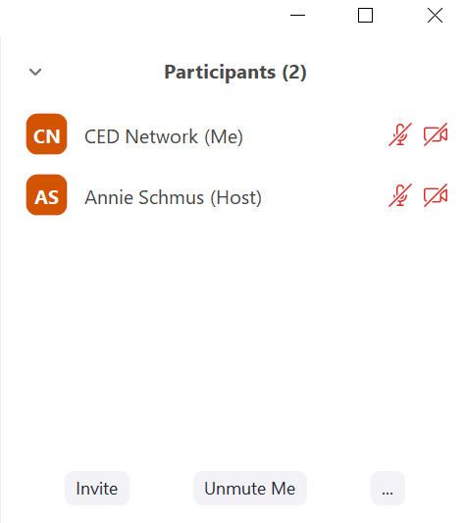
Roundtable Discussion
What realities have you experienced?
What are you learning from those you serve?
What future changes is your organization planning for?
To raise your hand
Click “participants” on the bottom of your screen
Then click on the “…” on the lower right of the participants menu
Then click on the “raise hand” option

Slide 26
Questions from the panelists
What are some successful pivots/changes you’ve made in recent months? (Could be related to strategy, targets, programming, etc.)
How are you balancing an increase in digital interaction with a desire for relationship, holistic impact?
What are new ways you plan to collaborate in the future? How might we collaborate with each other?
To raise your hand
Click “participants” on the bottom of your screen
Then click on the “…” on the lower right of the participants menu
Then click on the “raise hand” option

Slide 27
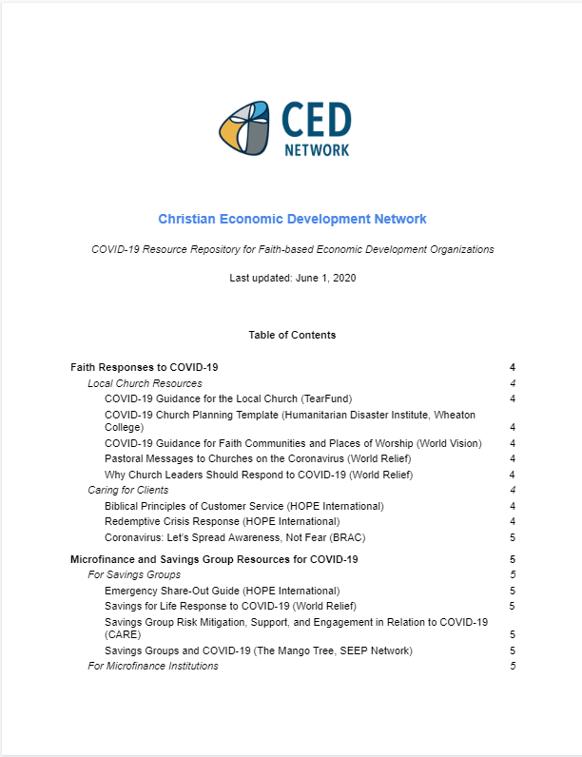
Stay connected
Invite others to join the CED Network for access future webinars, resources, and to receive today’s recording https://www.cednetwork.org/contact-us.html
View the new CED Resource Library at https://www.cednetwork.org/resource-library.html
Complete the CED 2020 interest survey (will be emailed to you along with today’s recording!)
Explore the COVID-19 Resource Repository for Faith-Based Economic Development Organizations at https://www.cednetwork.org/covid-19-resource-repository.html
Upcoming webinars:
Change Management (hosted by Accord) - July 30
Virtual Meetings, Trainings, and Events (hosted by HOPE) – Aug 5
Agriculture - late August

